Slide 1
Gathering Information at the Library
Notes:
User Tips:
1. After opening the pptx file immediately go to the menu and select File / Save As to create a new presentation. This way you will not override the original template file.
2. Use the 7 pre-designed slides as your template rather than using “New Slide” function on toolbar.
3. To use the same slide layout for multiple slides select the slide from the left hand side and use the Edit / Duplicate, make more than you need as you can remove extra slides later.
4. You can rearrange slide order by dragging the slide thumbnail up and down on the left hand side.
5. Font sizes and text –box sizes are only a base guide, some content may require a smaller or larger font which can be accomplished by selecting the text and using the Format function.
6. Pre-editing images to the proper image format (landscape, portrait, square) beforehand will ensure more accurate placement.
7. Remove extra slides and unused slides after the content has been inserted to eliminate them from appearing in your slideshow.

Slide 2
Have a project?
Don’t know where to start?
HPL can help with that!

Slide 3
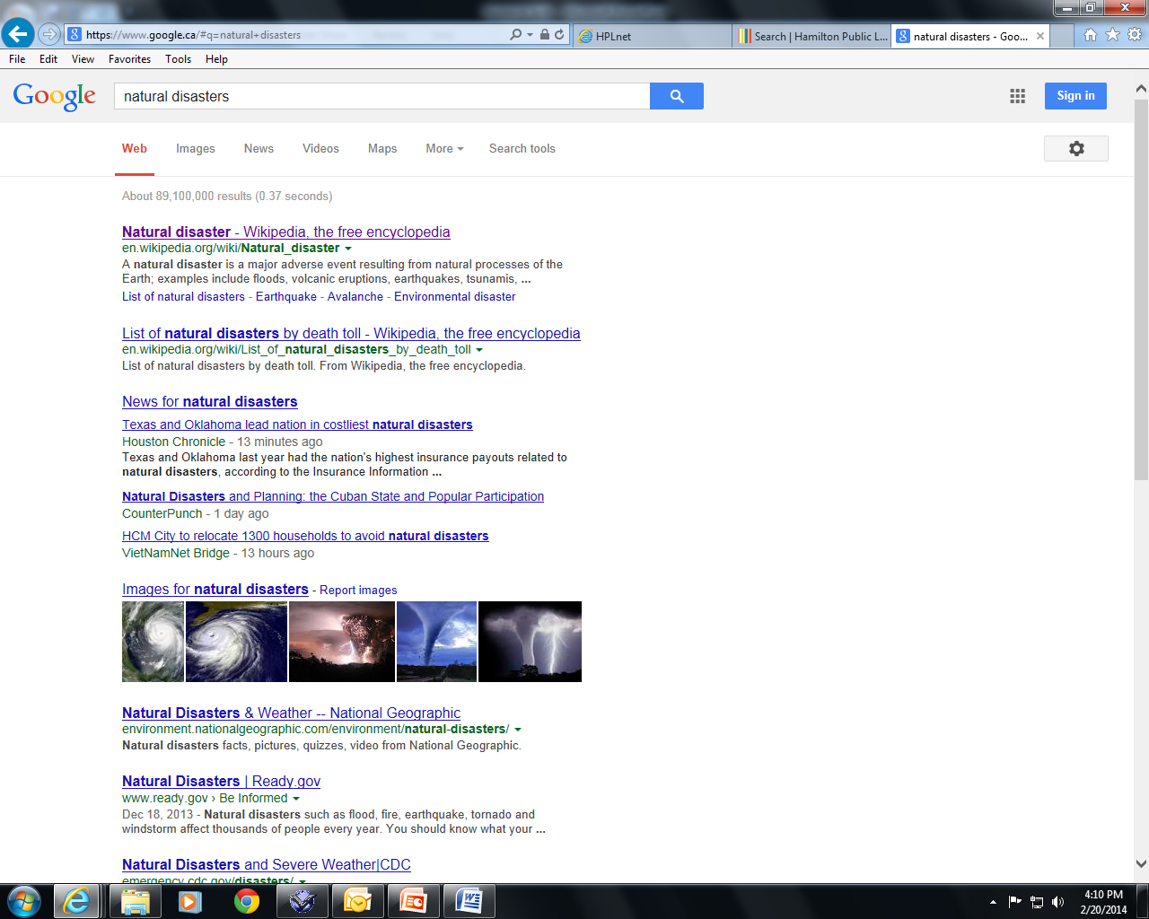
Step One: Narrow Your Topic
Most project topics are too big to research without narrowing them down
89 million is too many results!

Slide 4
Step One: Narrow Your Topic
First, learn about your general topic to choose an interesting specific topic.
Browse Google, encyclopedias, and reference books.
Wikipedia is a great place to start!
A note about Wikipedia:
  Anyone can post anything, so it’s not a trustworthy source.
  The place for Wikipedia is in the beginning of your research to help with general ideas.

Slide 5
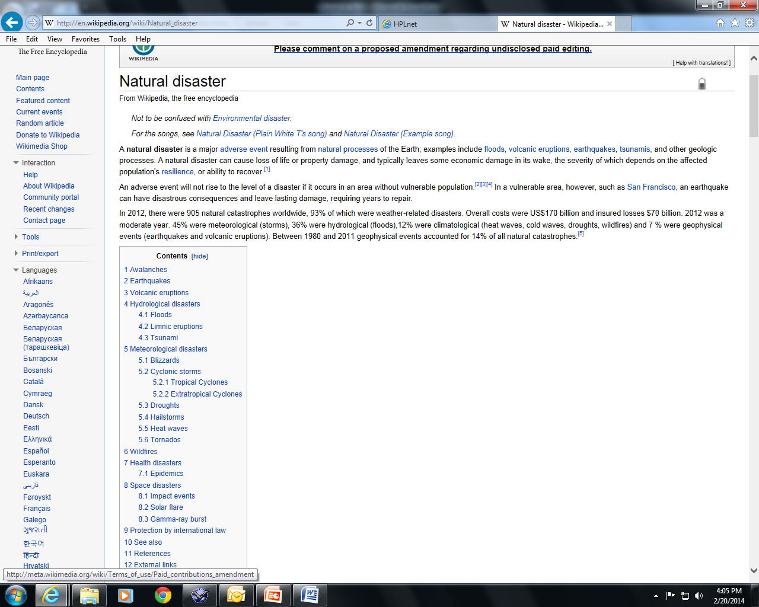
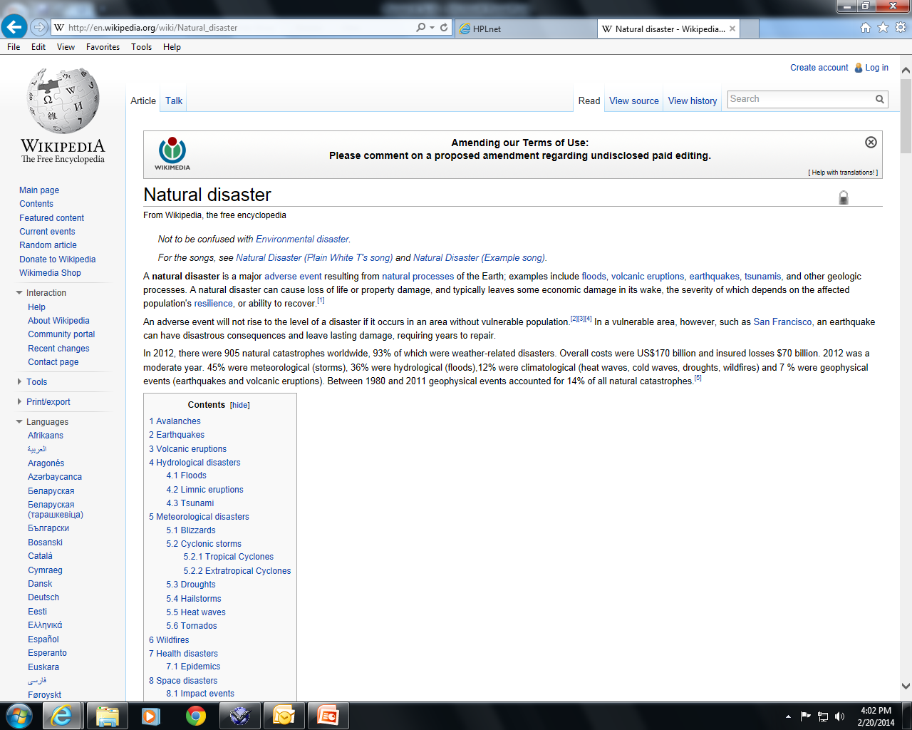
Subtopics!
The Table of Contents lets you jump to the section you want to read about.
The blue text in the main article links to other articles on specific subtopics.

Slide 6
Step One: Narrow Your Topic
Now that you’ve read about your big topic, you can choose an interesting and manageable small topic for your research project.
Example: Natural Disasters – Earthquakes
Now you are only researching earthquakes instead of everything about natural disasters!

Slide 7
Step Two: Look for Information
What are the two main types of sources you will be looking for?

Slide 8
Step Two: Look for Information
What are the two main types of sources you will be looking for?
Primary Sources = written at the time of the event being studied.
Secondary Sources = provide analysis of primary sources, usually written after the event being studied.

Slide 9
Step Two: Look for Information
What are the three main types of resources you use when looking for information for your project?
  Books

Slide 10
Step Two: Look for Information
What are the three main types of resources you use when looking for information for your project?
  Books
  Databases and Encyclopedias

Slide 11
Step Two: Look for Information
What are the three main types of resources you use when looking for information for your project?
  Books
  Databases and Encyclopedias
  Internet

Slide 12
Step Two: Look for Information
To find books, visit the library website or the HPL App.
To install the HPL app, visit the App store on your iPad or the Android Market on your Android, type HPL and tap “Install”.

Slide 13
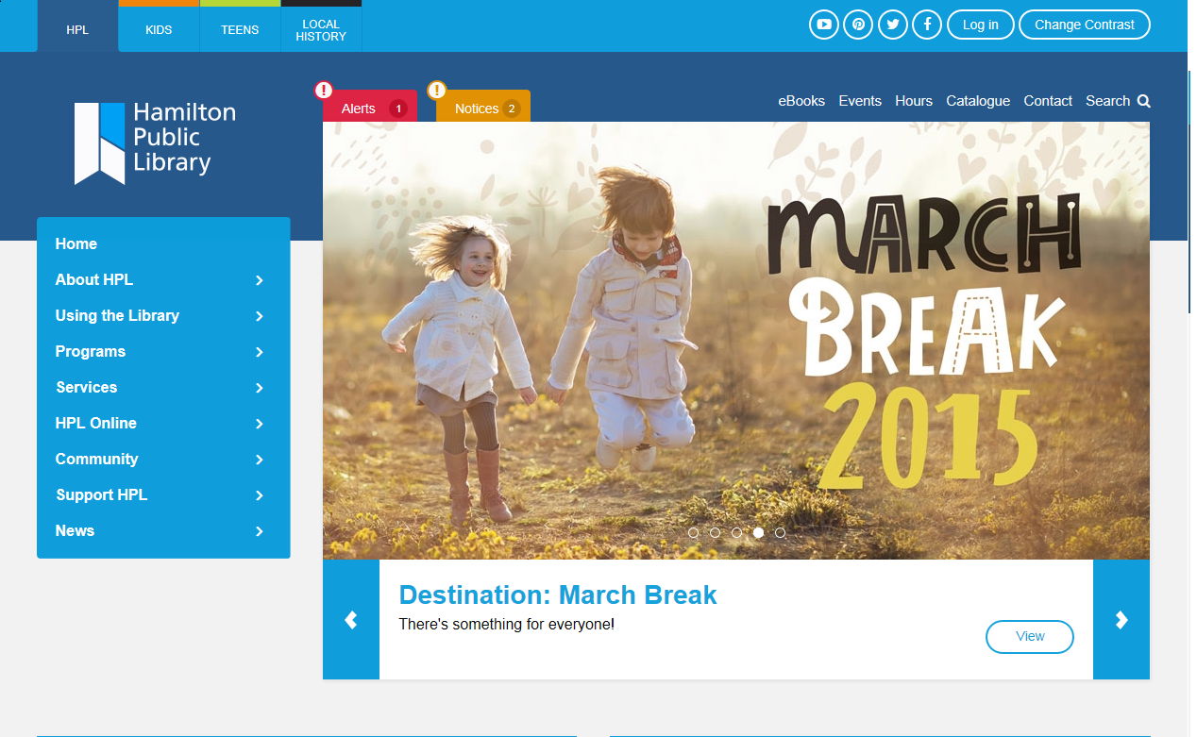
hpl.ca

Slide 14
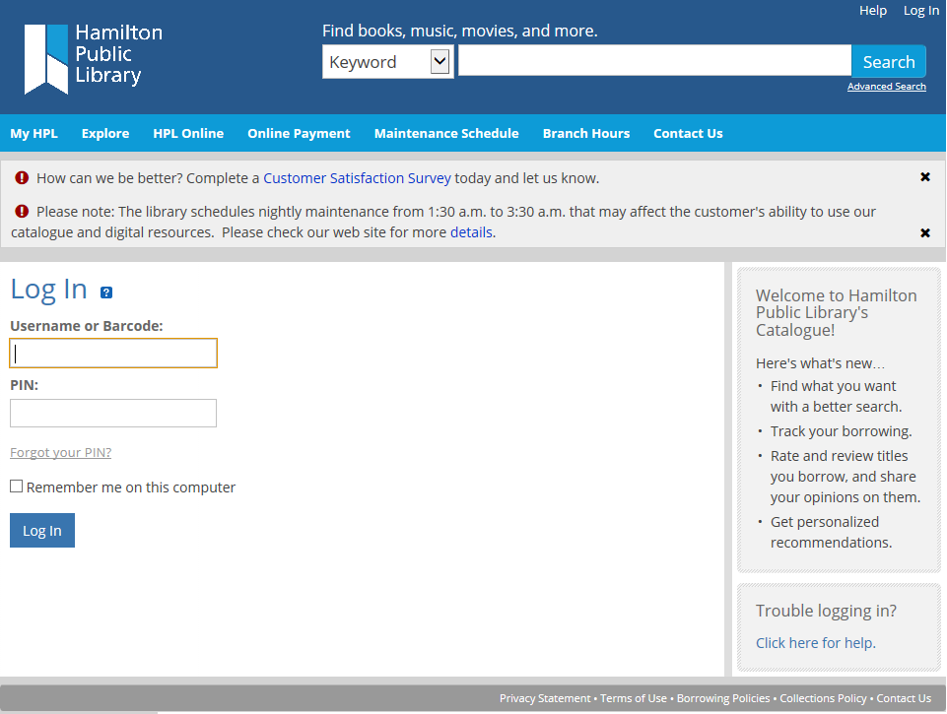
hpl.ca

Slide 15
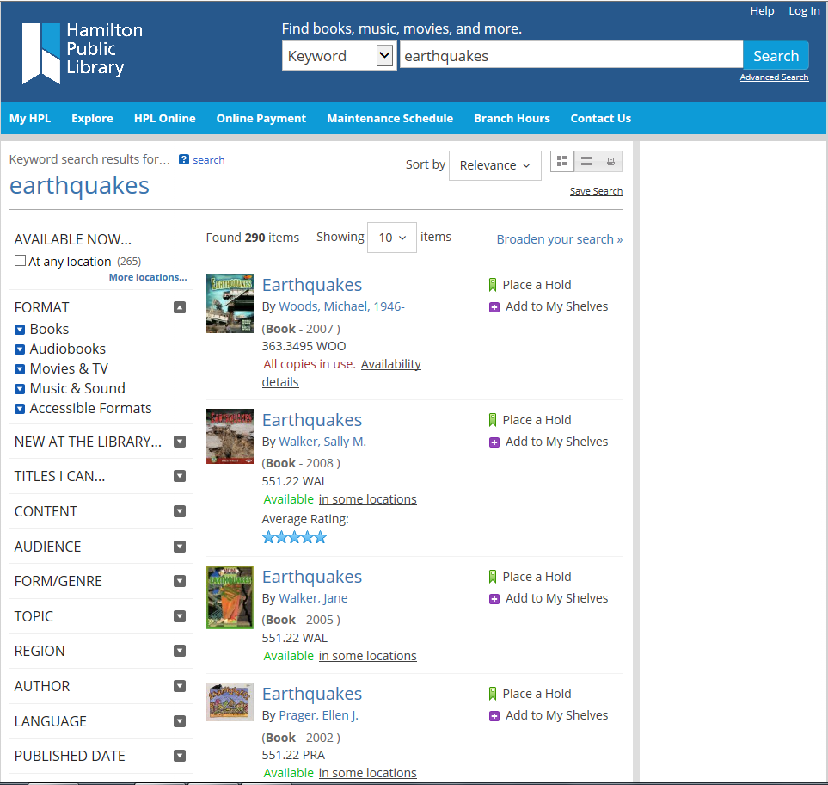
hpl.ca

Slide 16

Bring it home with this!

Slide 17
What if…
There aren’t enough books on my topic?
The information in the books is too old to be useful?
I need pictures and other graphics for my project?
I need primary sources?

Slide 18
What if…
There aren’t enough books on my topic?
The information in the books is too old to be useful?
I need pictures and other graphics for my project?
I need primary sources?
Check out HPL Databases!

Slide 19
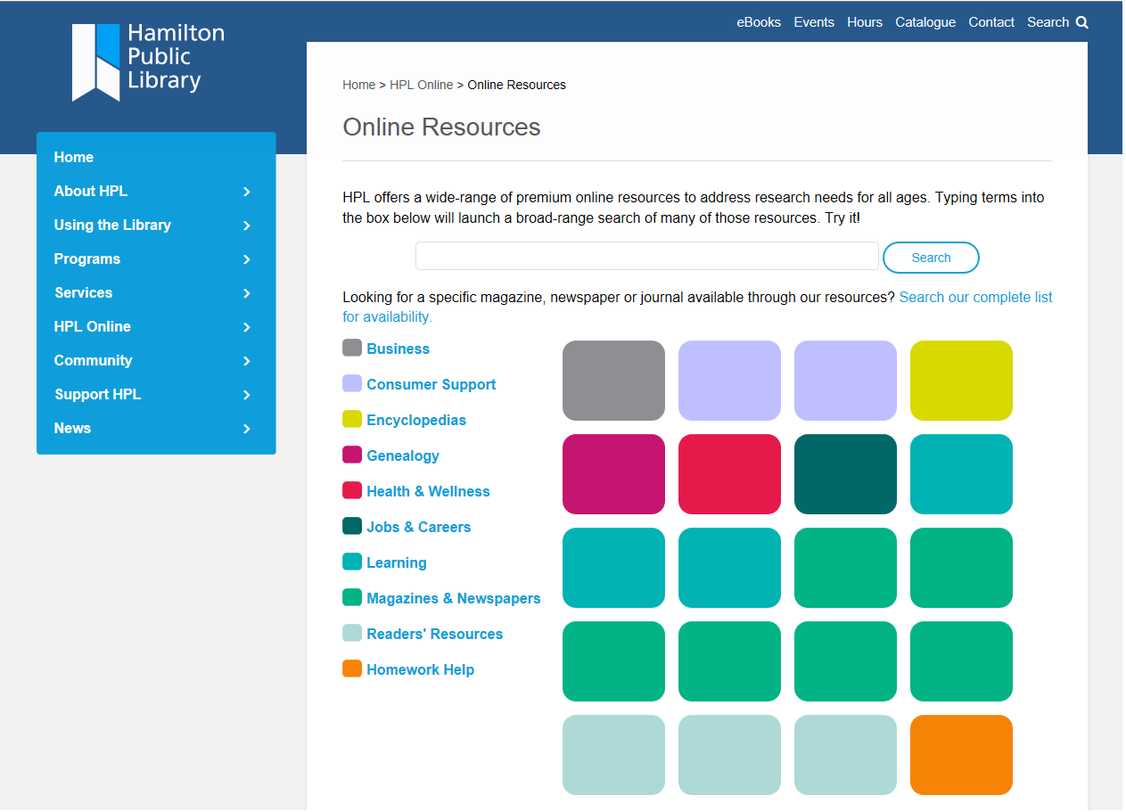
You can search across all databases or search specifically by subject.
You can search newspaper articles by date to find primary sources.

Slide 20
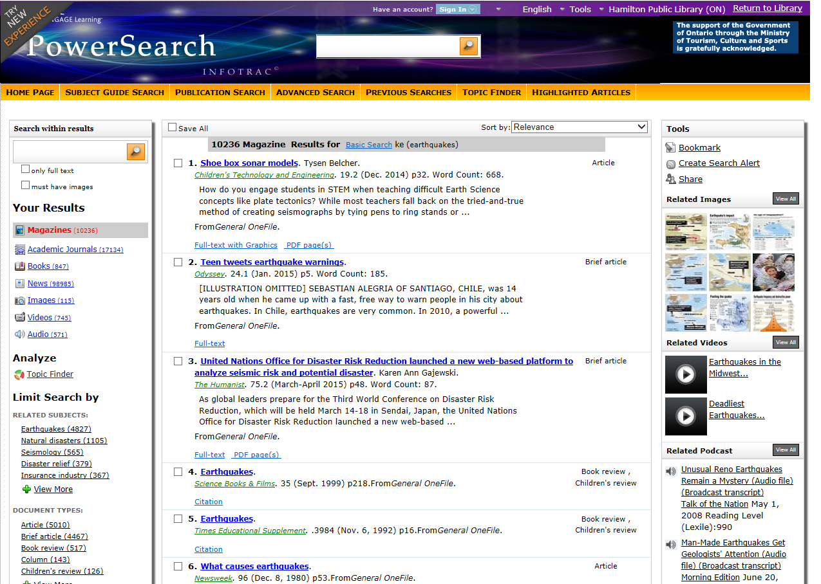
Click on relevant results to get the full article and limit by date to identify primary sources

Slide 21
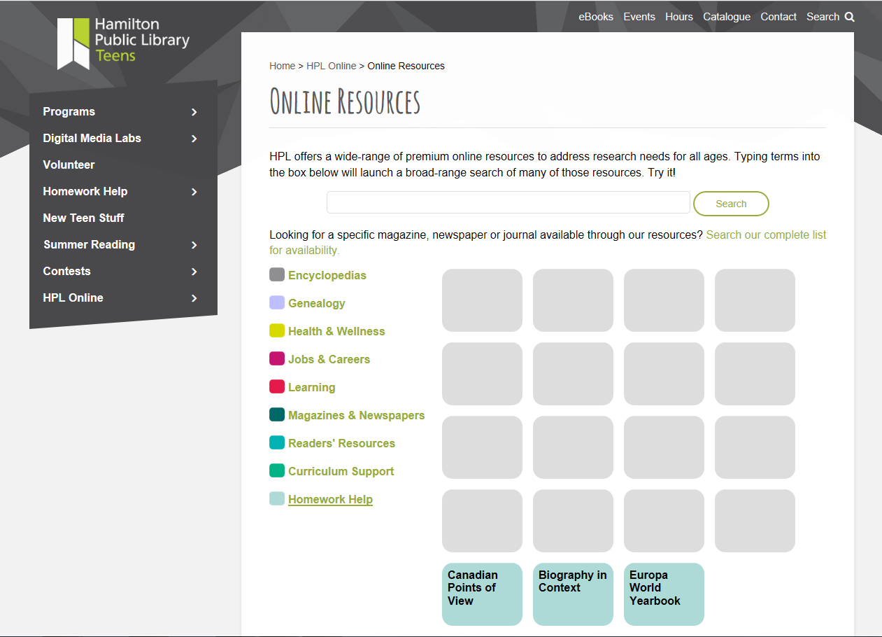
Check out our Homework Help page for even more helpful databases

Slide 22
Get More out of the Internet!
The Internet can be a great tool if you know how to use it well.
Just typing in keywords can get too many answers or information that won’t help you with your project.
Check for credibility by looking at the date of the post and the author of the website. A recent article about earthquakes written by an educational or government website is more credible than an older post written by a business or a member of the public.

Slide 23
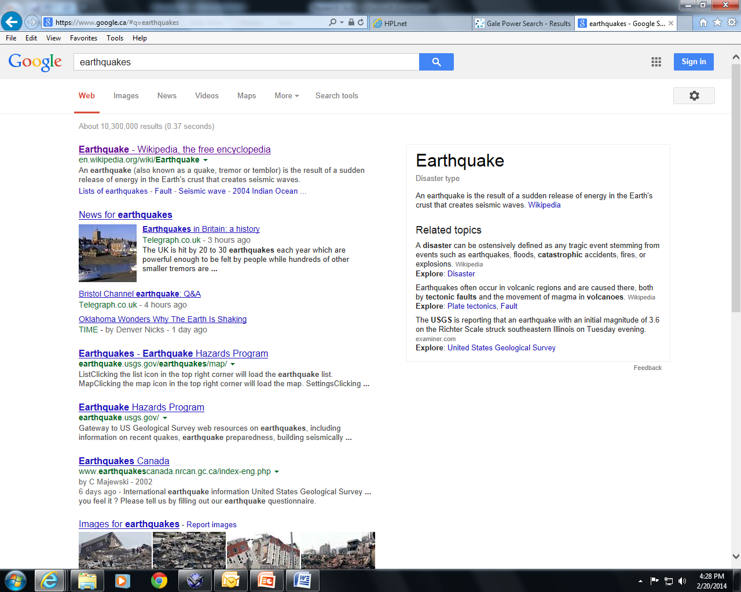
10 million is too many results!
Not what you’re looking for!

Slide 24
Want Better Answers? Use Smart Search Tools!
Quotation Marks (“”) let you search for
an exact phrase
ie: “Earthquakes in Canada”
A dash (-) before a word tells Google NOT toinclude that word in the search
ie: earthquakes –destruction means look for information about earthquakes but not about destruction

Slide 25
More Smart Search Tools...
A Tilde (~) before a word tells Google to include results with synonyms
ie: earthquakes ~destruction tells Google to
look for information about destruction,
collapse, damage, etc. due to earthquakes
Put two periods (..) between numbers to
search within a range
ie: earthquakes 2013..2014 will search for
earthquakes that have occurred between
2013 and 2014

Slide 26
And Even More!
Once you get comfortable with the basic smart search tools, try out some of the other ones found here: http://www.google.com/insidesearch/tipstricks

Slide 27
Step Three: Cite Your Sources
A bibliography lets your teacher know where you found your information.
There are different citation styles – find out which one your teacher prefers.
Some schools have their own citation guides.
A very helpful citation guide can be found here: https://owl.english.purdue.edu/

Slide 28
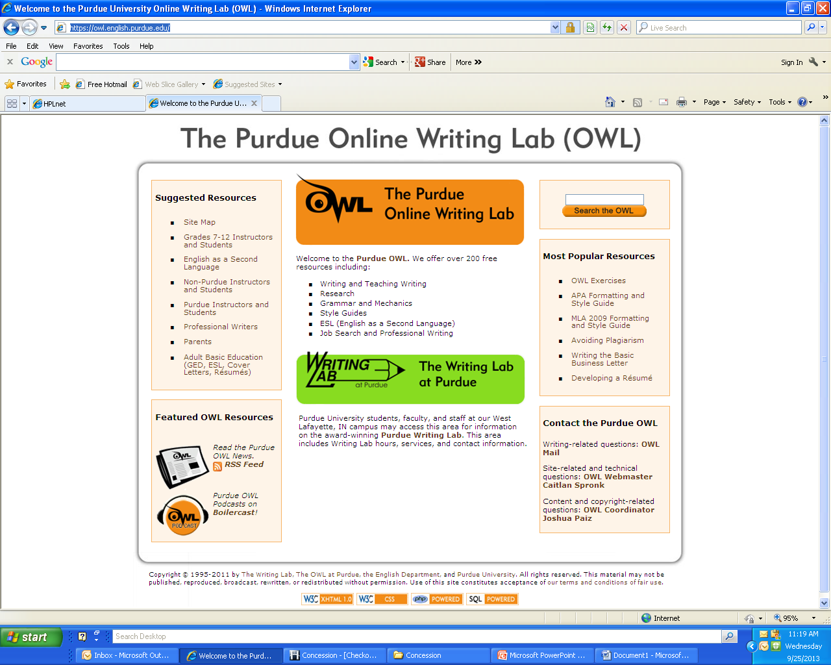
https://owl.english.purdue.edu/
APA and MLA are the two most common styles

Slide 29
We’re Always Here to Help!
If you have questions during the research process, you can:
1) Visit your local branch
2) Call 905-546-3200
3) Email askhpl@hpl.ca
4) Visit hpl.ca

